Slide 1
Big Data Algorithms and Tech​
Categorizing and Visualizing Computer Science Research Paper with ArXiV Data
GROUP 14
LIANG Tianyi 58276105
NIE Zhinie 58316899
CHEN Meng 58340501
部门：XXX

Slide 2
行业PPT模板http://www.1ppt.com/hangye/
Big Data Algorithms and Tech​
01
Background
01
CONTEN TS
02
Overview of Data
03
Realization
04
Conclusion & Other Attempts

Slide 3
Big Data Algorithms and Tech​
PART ONE
Background

Slide 4
Background
Big Data Algorithms and Tech​
Goals & Meanings
To uncover trends in computer science
To map out the landscape of current academic pursuits and breakthroughs
To seek some inspiration for our own future academic and career journey
Computational Resources
robust parallel computing tools (mainly used): Hadoop, Spark
additional tools: Python,R
They were used to enable an in-depth analysis of prevailing research trends in computer science, ensuring that our exploration is comprehensive despite computational limitations.

Slide 5
Big Data Algorithms and Tech​
PART TWO
Overview of Data

Slide 6
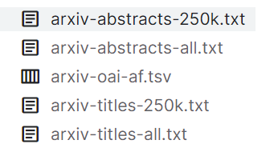
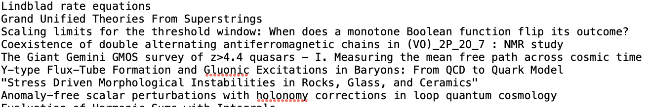
Overview of Data
Big Data Algorithms and Tech​
Source:
Over 1.5 Million research papers metadata in different fields hosted on Arxiv from Q1 1993 to Q3 2019, including paper titles and abstracts…
Link:https://www.kaggle.com/datasets/tayorm/arxiv-papers-metadata
Data:
We used two documents: arxiv-abstracts-all.txt, arxiv-titles-all.txt
The descriptions of arxiv-abstracts-all.txt are as follows:
Data Attribute | Description
Format | TXT
Size | 1.79 GB
Record Count | 1,578,655
The text data is raw and unprocessed, containing original formatting with no stemming, punctuation removal, or case normalization applied.

Slide 7
Big Data Algorithms and Tech​
PART THREE
Realization

Slide 8
Workflow
Big Data Algorithms and Tech​
Data preprocessing
TF-IDF Processing
Data Clustering
Visualization
Titles and abstracts combination
Case conversion
Punctuation removal
Special characters removal
Stopwords removal
Stemming
Tokenizer
HashingTF
IDF
K-means
Wordcloud
Knowledge graph
Parallel computing using Hadoop and spark
Python&R

Slide 9
Data preprocessing
Big Data Algorithms and Tech​
Configuring
environment
Data loading
Data cleaning
Apache Spark 3.5.0
The old version of spark lack adequate support for Natural Language Processing (NLP) and Machine Learning (ML)
Data Reading
Abstracts and titles of papers are read from HDFS
Combination : Application of Cleaning Process,applying the cleanData function to both abstract and title data using the map function
Conversion to Lowercase: By invoking the toLowerCase(), we convert the text to lowercase.
Removal of Non-Alphanumeric Characters: We use regular expressions to remove all non-alphanumeric characters, such as punctuation.
Removal of Stopwords: Common stop words are removed using the StopWordsRemover from the Spark ML library.
Stemming: Stemming is performed using the Spark NLP library, which reduces words to their base form .

Slide 10

Data preprocessing
Big Data Algorithms and Tech​
Difficulty:
During the data processing phase with Apache Spark, it was identified that the existing version, 1.2.0, lacked adequate support for Natural Language Processing (NLP) and Machine Learning (ML), particularly in the context of text cleansing tasks.
Solution:
To address this limitation, the system environment was reconfigured, facilitating an upgrade to Apache Spark version 3.5.0. This newer version encompasses the necessary capabilities for advanced text processing workflows required in our project.

Slide 11
TF-IDF Processing
Big Data Algorithms and Tech​
Tokenization
Utilizing the Tokenizer to segment text data into a list of words, transforming each abstract into a series of individual words
Frequency Transformation
Applying HashingTF to calculate the frequency of each word and mapping these words to a fixed-size vector space.
After the HashingTF transformation, Spark internally converted DataFrames into RDDs for processing
Inverse Document
Frequency Transformation
Using IDF to transform term frequency features, thereby generating TF-IDF vectors.
Compared to traditional TF-IDF techniques, we utilized HashingTF and IDF methods for text processing, which are better suited for large datasets and can reduce computing time.
However, we also encountered situations where HashingTF mapped different texts to the same feature index, resulting in information loss.
RDD was used to transform TF-IDF vectors into dense vectors, which was to meet the formatting requirements of the K-Means input. RDD is particularly effective in handling complex data transformations that require large-scale parallel computing.
Notes:
在上述过程中，“denseVectorData”这一步涉及到了RDD的使用。RDD（Resilient Distributed Dataset）是Spark的一个基本的数据结构，代表一个不可变的、容错的、分布式的数据集合。在这段代码中，tfidfData.select("features").rdd将DataFrame中的"features"列转换为RDD，然后通过map函数操作，将每个行的TF-IDF向量转换为稠密向量，并将它们和原始的稀疏向量作为新DataFrame的两列。这样做是为了满足K-Means算法输入数据的格式要求，因为K-Means算法在Spark中通常需要稠密向量作为输入。
在进行HashingTF转换之后，Spark内部将DataFrame转换为RDD进行处理。RDD（Resilient Distributed Dataset，弹性分布式数据集）是Spark的一个基本构建块，它提供了几个关键优势：
弹性和容错性：RDD能够容忍节点故障，自动重建丢失的数据分区，保证了数据处理过程的稳定性和可靠性。
分布式处理：RDD天生支持分布式处理，允许数据在集群的多个节点上并行处理。这大大提高了处理大规模数据集的效率和速度。
高效的数据流转：RDD优化了数据流转过程，减少了不必要的数据读写操作，提高了整体的数据处理效率。
灵活的转换操作：RDD提供了丰富的转换操作，如map、filter、reduce等，这些操作可以灵活地应用于数据集，以实现复杂的数据处理和分析。
通过将DataFrame转换为RDD，Spark利用了RDD的这些优势，为HashingTF之后的数据处理提供了强大的支持。这种处理方式在处理需要大规模并行计算的复杂数据转换时尤其有效。

Slide 12
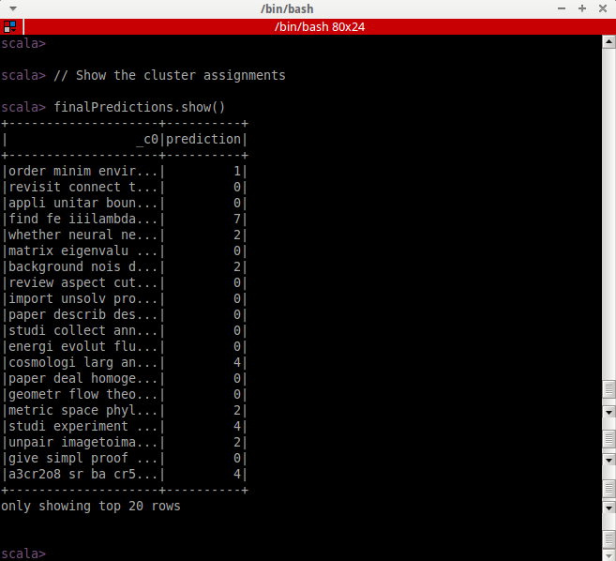
Data Clustering
Big Data Algorithms and Tech​
When performing clustering with K-means, we chose 8 clusters, based on the main academic fields of ArXiv. ArXiv encompasses a range of key areas from mathematics and physics to computer science, representing the most active and extensively researched topics on the platform.
We found that the output results from Spark can be unordered, so we paired the samples and labels during the Spark runtime in order to generate the desired output. We have also adopted this approach in data preprocessing and vectorization.
We reviewed the abstracts of different clusters and identified clusters related to computer science. We used the corresponding abstracts for data visualization later.

Slide 13
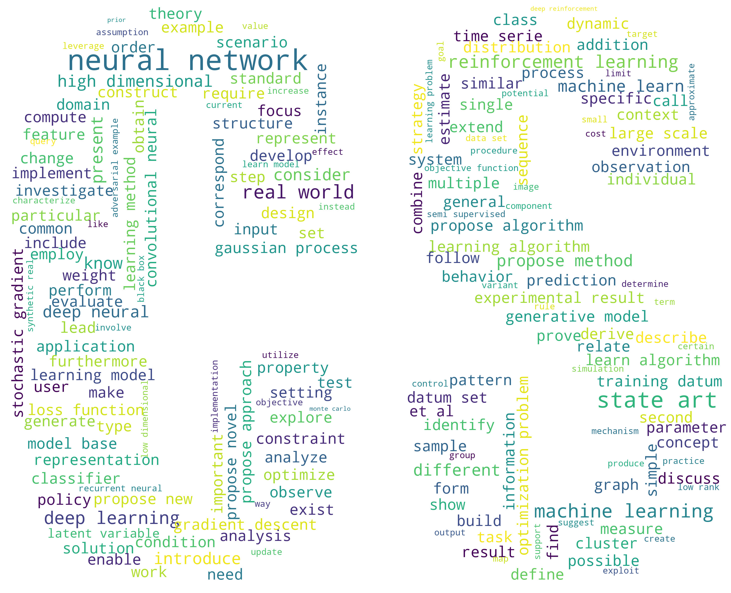
Visualization
wordcloud
Big Data Algorithms and Tech​
Artificial Intelligence and Machine Learning Focus:
The prominence of terms like "neural network" and "machine learning" in the word cloud suggests a widespread research interest and discussion in these areas within the computer science domain.
Technological Advancement Trends
The term "state of the art" reflects a concentration on the latest developments in algorithms or system designs, indicating a push toward cutting-edge technology in research.
Algorithmic Research
The standout word "algorithm" signifies the key importance of algorithm research, with scholars seeking new or improved algorithms for better performance.
Deep Learning Applications
Keywords such as "deep learning," "gradient," and "classifier" denote the focus on deep learning technologies and their applications across various domains.

Slide 14
Visualization
Knowledge graph
Big Data Algorithms and Tech​
Method：
According to the entity library en_core_web_sm in NLTK, we selected the top 70 entities with the highest frequency from the cs abstracts, and used them to create a knowledge graph.
Tool：
We used the Python to build the knowledge graph, and due to the input of over 100000 records, it took a long time to run.
We also tried Python’s Multiprocessing library for parallelism, which reduced the runtime but was not significant.
We also tried the Joblib library, but it couldn't run successfully.
In fact, this task is not particularly suitable for parallel computing in Python, because there are some logical dependencies between the code.
Tool used | Run time
Python only | 1h 28min 38sec
Python with Multiprocessing | 55 min 5sec

Slide 15
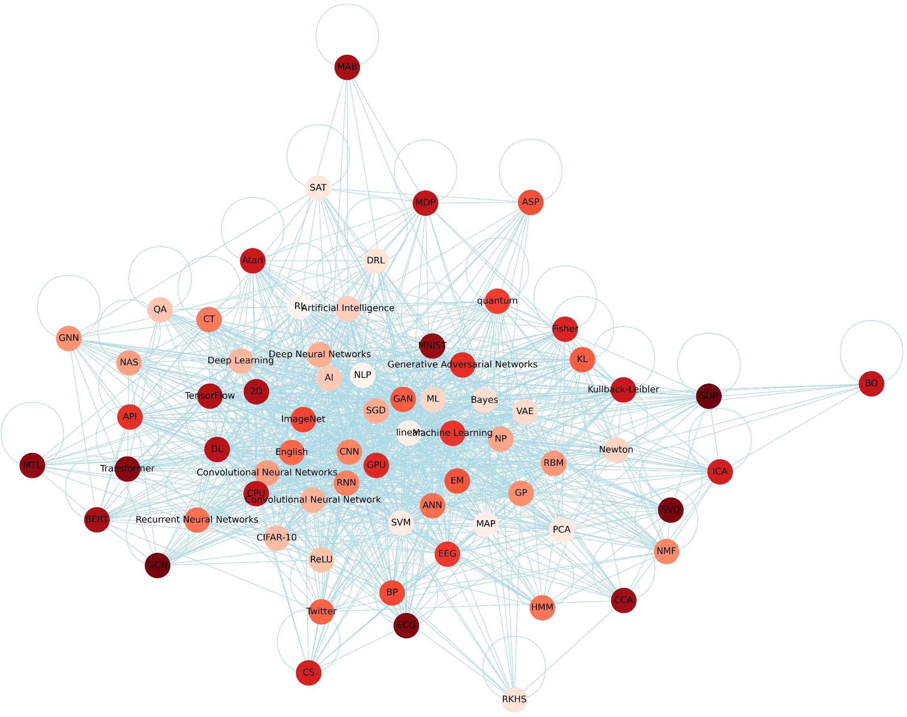
Visualization
Knowledge graph
Big Data Algorithms and Tech​
These nodes represent entities with a high frequency of occurrence, and these edges represent the relationships between entities.
We can conclude that(just a few conclusions):
The dominance of Deep Learning
Central words like "CNN," "RNN," and "GAN" indicate the dominance of deep learning techniques in current computer science research, especially in image and speech processing, and new data generation.
Importance of computing power
The salience of "GPU" as a central term points out the key role of high performance computing in modern research, especially in the training of deep learning models.

Slide 16
Big Data Algorithms and Tech​
PART FOUR
Conclusion&
Other Attempts

Slide 17


Conclusion
Big Data Algorithms and Tech​
Conclusion
Current computer science research focuses on the development of deep learning and explores advanced techniques and algorithms within the broad field of machine learning.
Practical significance
Research Direction Guidance:
Understanding the current focus areas in computer science can direct our future research or studies.
Career Planning:
Knowledge of these key technological areas can inform our career planning, especially if we are considering entering a tech-intensive industry or expanding our skill set to meet the demands of the future job market.

Slide 18
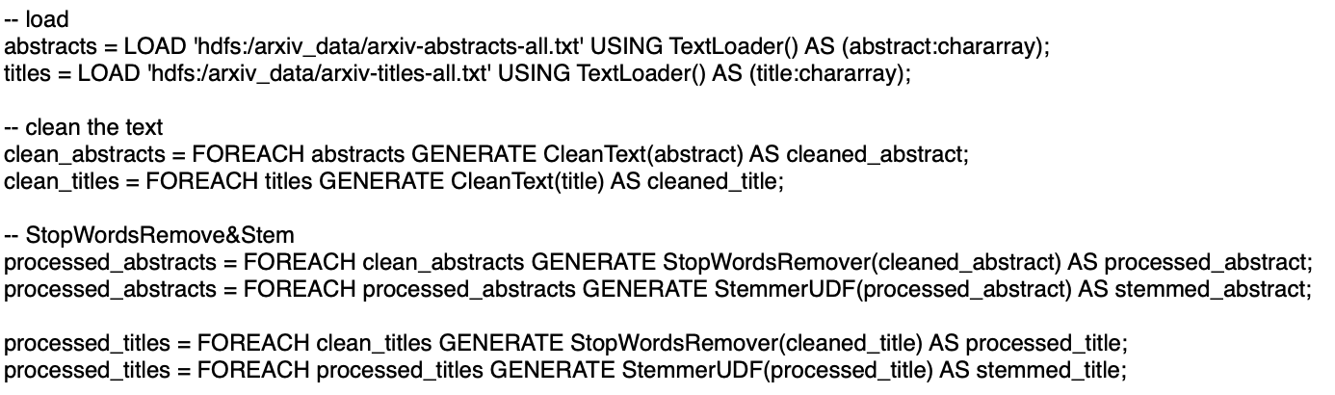
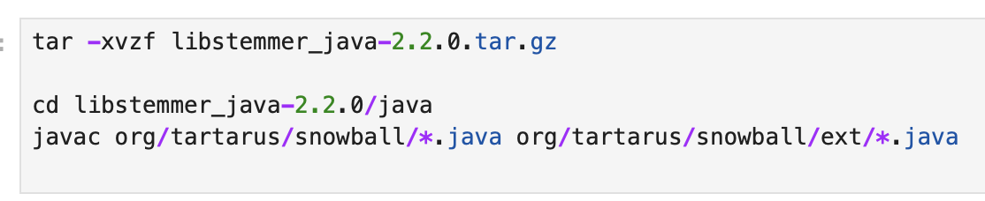



Other Attempts
Big Data Algorithms and Tech​
Data preprocessing approach using UDFs (User-Defined Functions) in Pig
Create the pig script process_data.pig
UDFs are created to perform text processing
Download the snowball library for stemming
Environment configuration
However, the program kept throwing an error (ERROR 1070: Could not resolve myudfs.CleanText using imports: [...]), and despite our attempts with various methods to resolve it, we were unsuccessful.
This led us to switch to a Hadoop-based Spark solution.

